Slide 1
TRAFFIC STATE ESTIMATION USING FLOATING CAR DATA
Abhinav Sunderrajan, Vaisagh Viswanathan, Wentong Cai and Alois Knoll
Presented by: Abhinav Sunderrajan

Slide 2
Agenda
Background and motivation
Methodology
Experiments
Results
Conclusions and Future Work
Notes:
30s

Slide 3
Agenda
Background and motivation
Methodology
Experiments
Results
Conclusions and Future Work

Slide 4
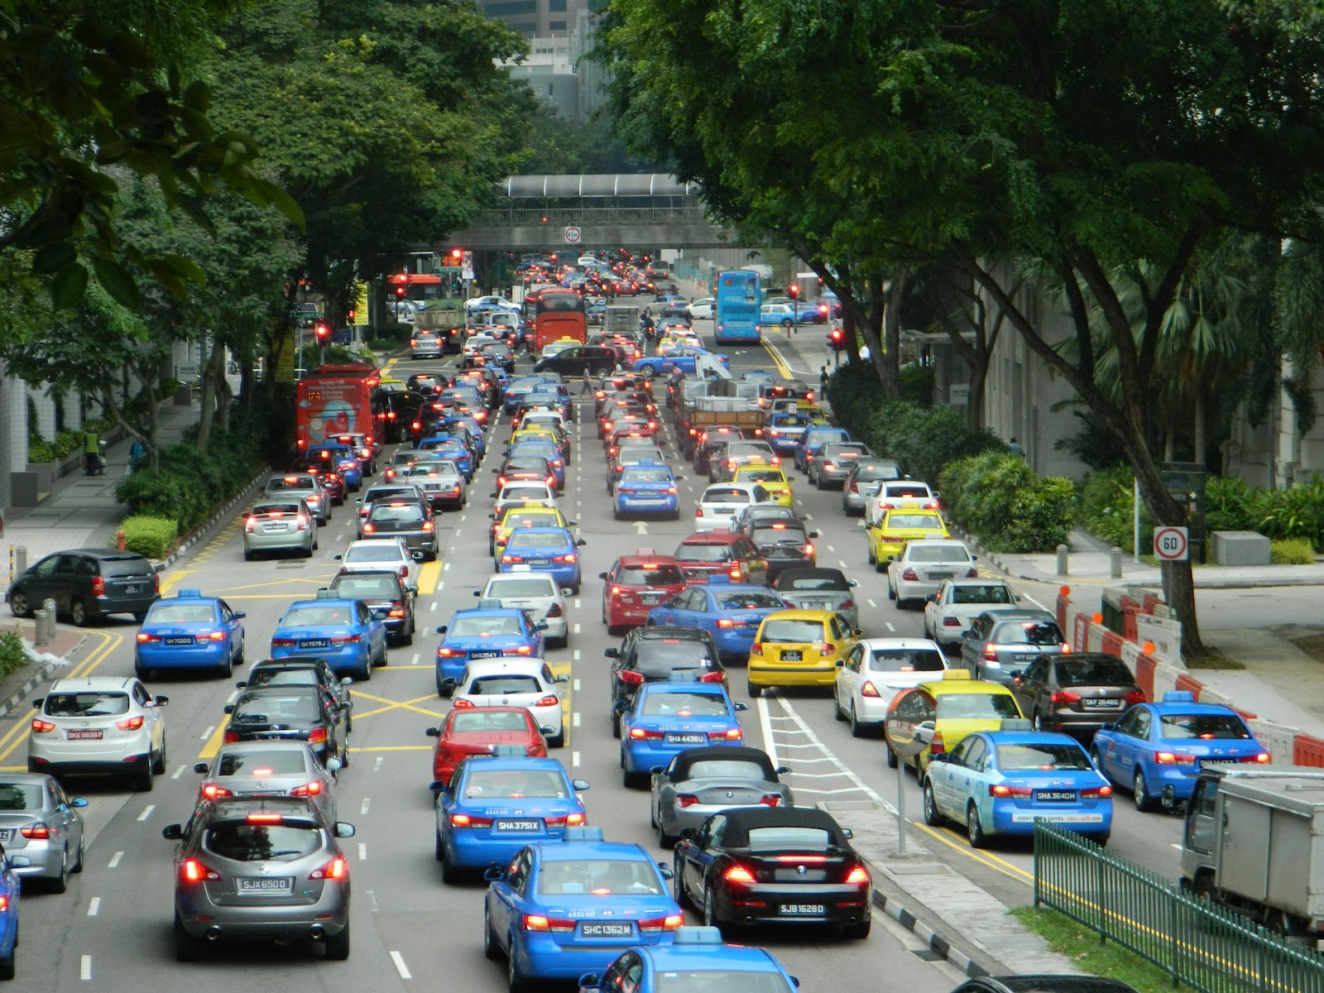
Background and Motivation
Increasing availability of real-time floating car data (FCD)
Taxis and busses equipped with GPS devices.
Anonymized users seeking route guidance from in car navigation systems
GPS accuracy has improved from 15m in the past to about 3m to 5m today.
Notes:
Lots of GPS data available nowadays.

Slide 5
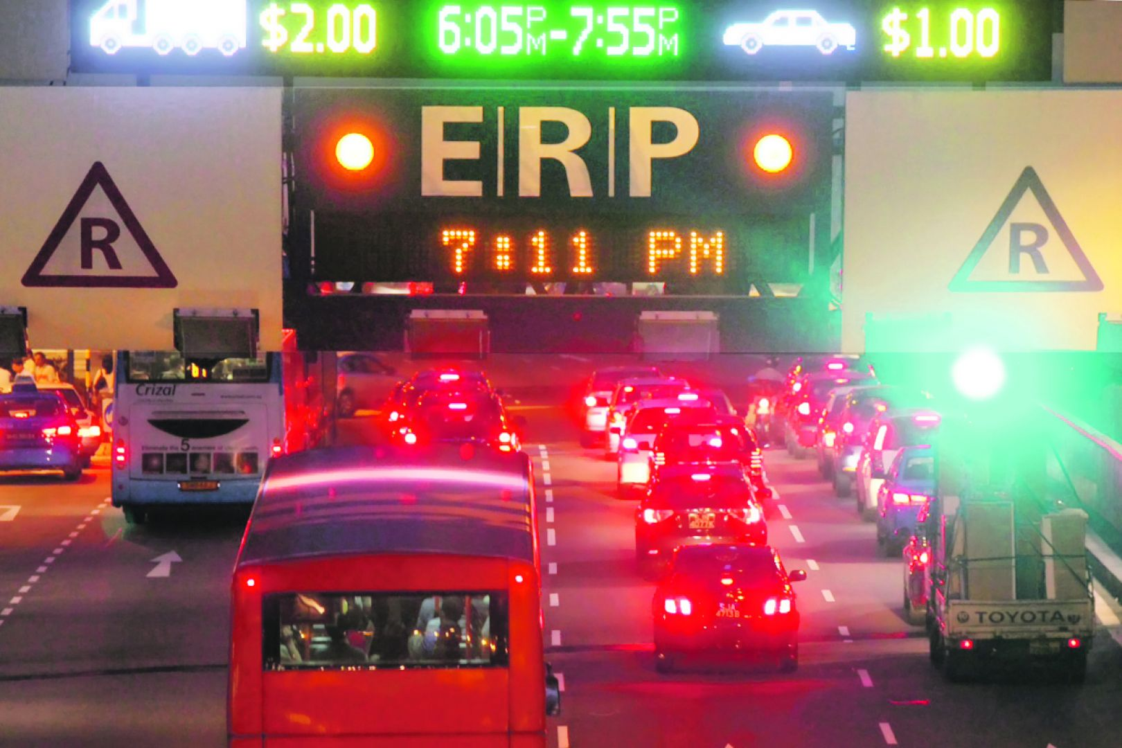
Background and Motivation
Next generation ERP could be Global navigation satellite system based.
Thus most vehicles will have GPS receivers emitting data such as location and speed at fixed time intervals.
Notes:
Singapore ERP2.0 2020 in plan.

Slide 6

Background and Motivation
Can we leverage this real-time data stream (along with the data from traditional fixed sensors) for current traffic state estimation?
Notes:
I’ll clarify on what I mean by traffic state in minute.

Slide 7
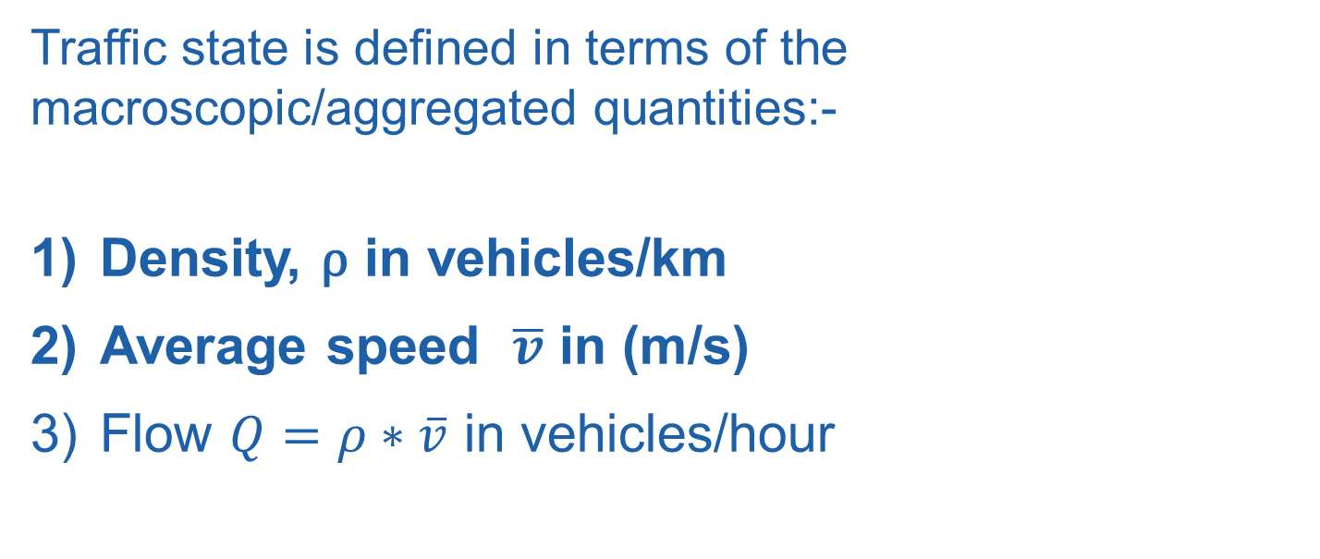
Background and Motivation
Traffic state is defined in terms of the macroscopic/aggregated quantities:-
Density, ρ in vehicles/km
Average speed $\overline{v}$ in (m/s)
Flow $Q=ρ∗\overline{v}$ in vehicles/hour

Slide 8
Background and Motivation
We thus developed a methodology for obtaining the aggregated macroscopic traffic state from the microscopic floating car data (FCD).
FCD is represented by the tuple <vehicle-id, speed, latitude, longitude, time>.
We are concerned with spatial aggregation of FCD and assume the time-period of temporal aggregation to be equal to two minutes.

Slide 9
Background and Motivation
The partitioned regions must be microscopically large enough to contain sufficient samples of the FCD tuples.
The regions should also be macroscopically small to determine traffic patterns of interest such as congestion and variations in flow.
In other words the task boils down to identifying regions of homogeneous traffic flow along the road network given varying speeds in different lanes of a road link.

Slide 10
Background and Motivation
We also estimate the minimum percentage of probe vehicles (of total traffic) required for traffic state reconstruction.
This is also referred to as minimum probe penetration.
The minimum probe penetration is also investigated for different traffic scenarios by simulating a real world expressway.

Slide 11
Agenda
Background and motivation
Methodology
Experiments
Results
Conclusions and Future Work

Slide 12
Methodology
Algorithm for determining current traffic state of an expressway from FCD
Make use of the topology of the expressway to divide into sections between on/off ramp pairs
Naively divide the expressway into 13 segments of length 1.0 km each
Recursive binary splitting
Naïve Partitioning
Topological Partitioning

Slide 13
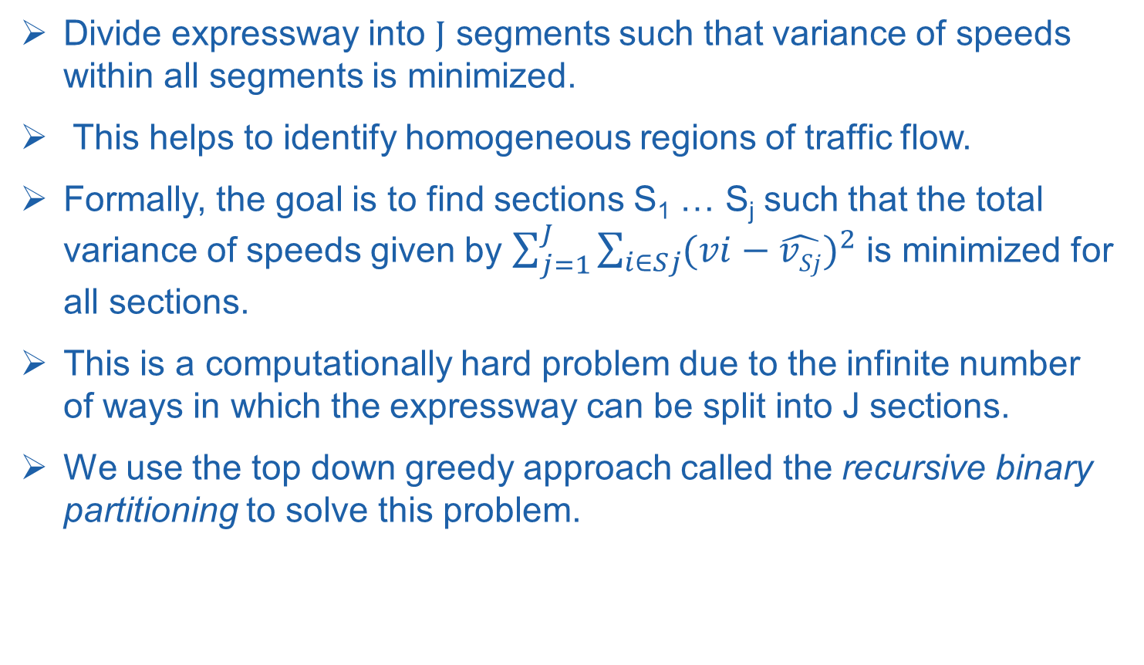
Methodology
RECURSIVE BINARY PARTITIONING OF EXPRESSWAY FOR SPATIAL AGGREGATION OF FCD
Divide expressway into J segments such that variance of speeds within all segments is minimized.
This helps to identify homogeneous regions of traffic flow.
Formally, the goal is to find sections S₁ … S_{j} such that the total variance of speeds given by $\sum_{j=1}^{J}{\sum_{i∈Sj}{{(vi−\hat{vSj})}^{2}}}$ is minimized for all sections.
This is a computationally hard problem due to the infinite number of ways in which the expressway can be split into J sections.
We use the top down greedy approach called the recursive binary partitioning to solve this problem.

Slide 14
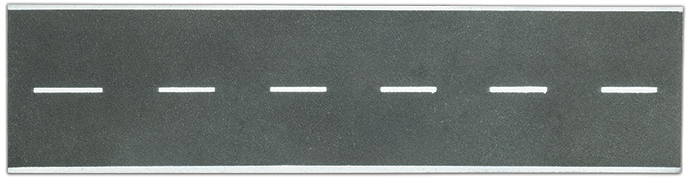

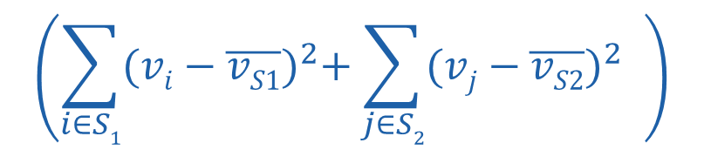
Methodology
RECURSIVE BINARY PARTITIONING OF EXPRESSWAY FOR SPATIAL AGGREGATION OF FCD
Stretch of expressway with floating cars
Split expressway into two sections S₁ and S₂ to minimize
$$\left(\sum_{i∈S1}{{(vi−\overline{vS1})}^{2}+\sum_{j∈S2}{{(vj−\overline{vS2})}^{2}} }\right)$$

Slide 15
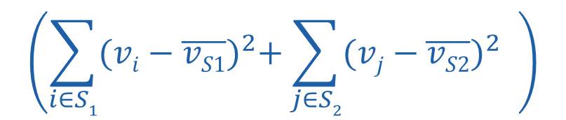
Methodology
RECURSIVE BINARY PARTITIONING OF EXPRESSWAY FOR SPATIAL AGGREGATION OF FCD
S₁
S₂
Split expressway into two sections S₁ and S₂ to minimize
$$\left(\sum_{i∈S1}{{(vi−\overline{vS1})}^{2}+\sum_{j∈S2}{{(vj−\overline{vS2})}^{2}} }\right)$$

Slide 16
Methodology
RECURSIVE BINARY PARTITIONING OF EXPRESSWAY FOR SPATIAL AGGREGATION OF FCD
S₁
S₂
Split expressway into two sections S₁ and S₂ to minimize
$$\left(\sum_{i∈S1}{{(vi−\overline{vS1})}^{2}+\sum_{j∈S2}{{(vj−\overline{vS2})}^{2}} }\right)$$

Slide 17
Methodology
RECURSIVE BINARY PARTITIONING OF EXPRESSWAY FOR SPATIAL AGGREGATION OF FCD
S₁
S₂
The above split minimizes
$$\left(\sum_{i∈S1}{{(vi−\overline{vS1})}^{2}+\sum_{j∈S2}{{(vj−\overline{vS2})}^{2}} }\right)$$

Slide 18


Methodology
S₁
S₂
S₃
S₄
S₅
S₆
Recursively split segment S₁ into segments S₃ and S₄
Recursively split S₂ into segments S₅ and S₆

Slide 19
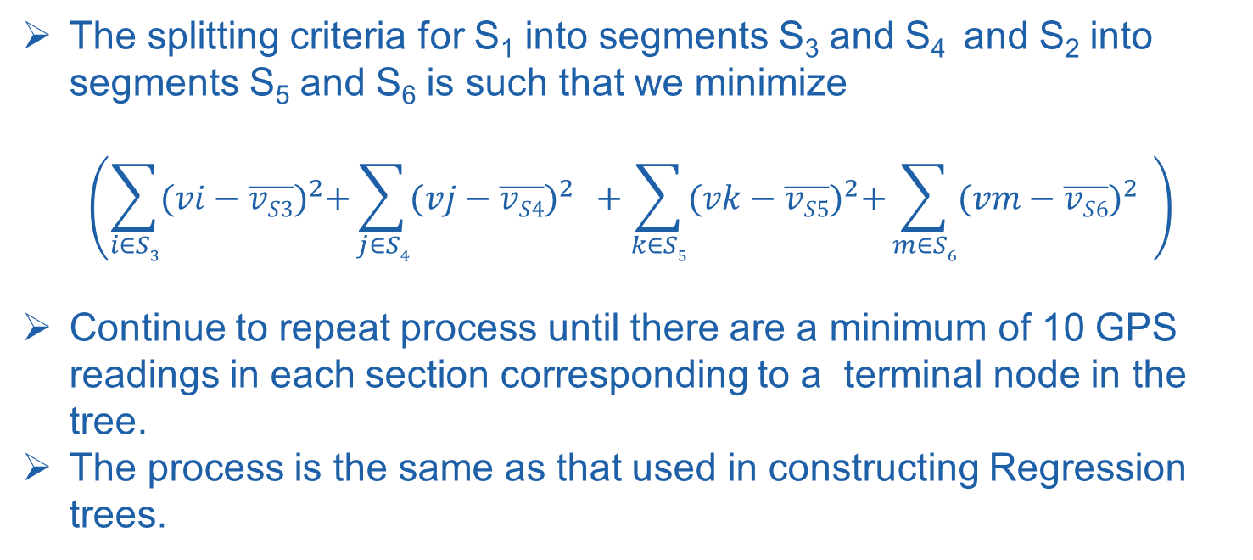
Methodology
The splitting criteria for S₁ into segments S₃ and S₄ and S₂ into segments S₅ and S₆ is such that we minimize
$$\left(\sum_{i∈S3}{{(vi−\overline{vS3})}^{2}+\sum_{j∈S4}{{(vj−\overline{vS4})}^{2}} }+\sum_{k∈S5}{{(vk−\overline{vS5})}^{2}+\sum_{m∈S6}{{(vm−\overline{vS6})}^{2}} }\right)$$
Continue to repeat process until there are a minimum of 10 GPS readings in each section corresponding to a terminal node in the tree.
The process is the same as that used in constructing Regression trees.

Slide 20
Agenda
Background and motivation
Methodology
Experiments
Traffic Simulation
The simulated environment
Simulation parameters and Simulation scenarios
Results
Conclusions and Future Work

Slide 21
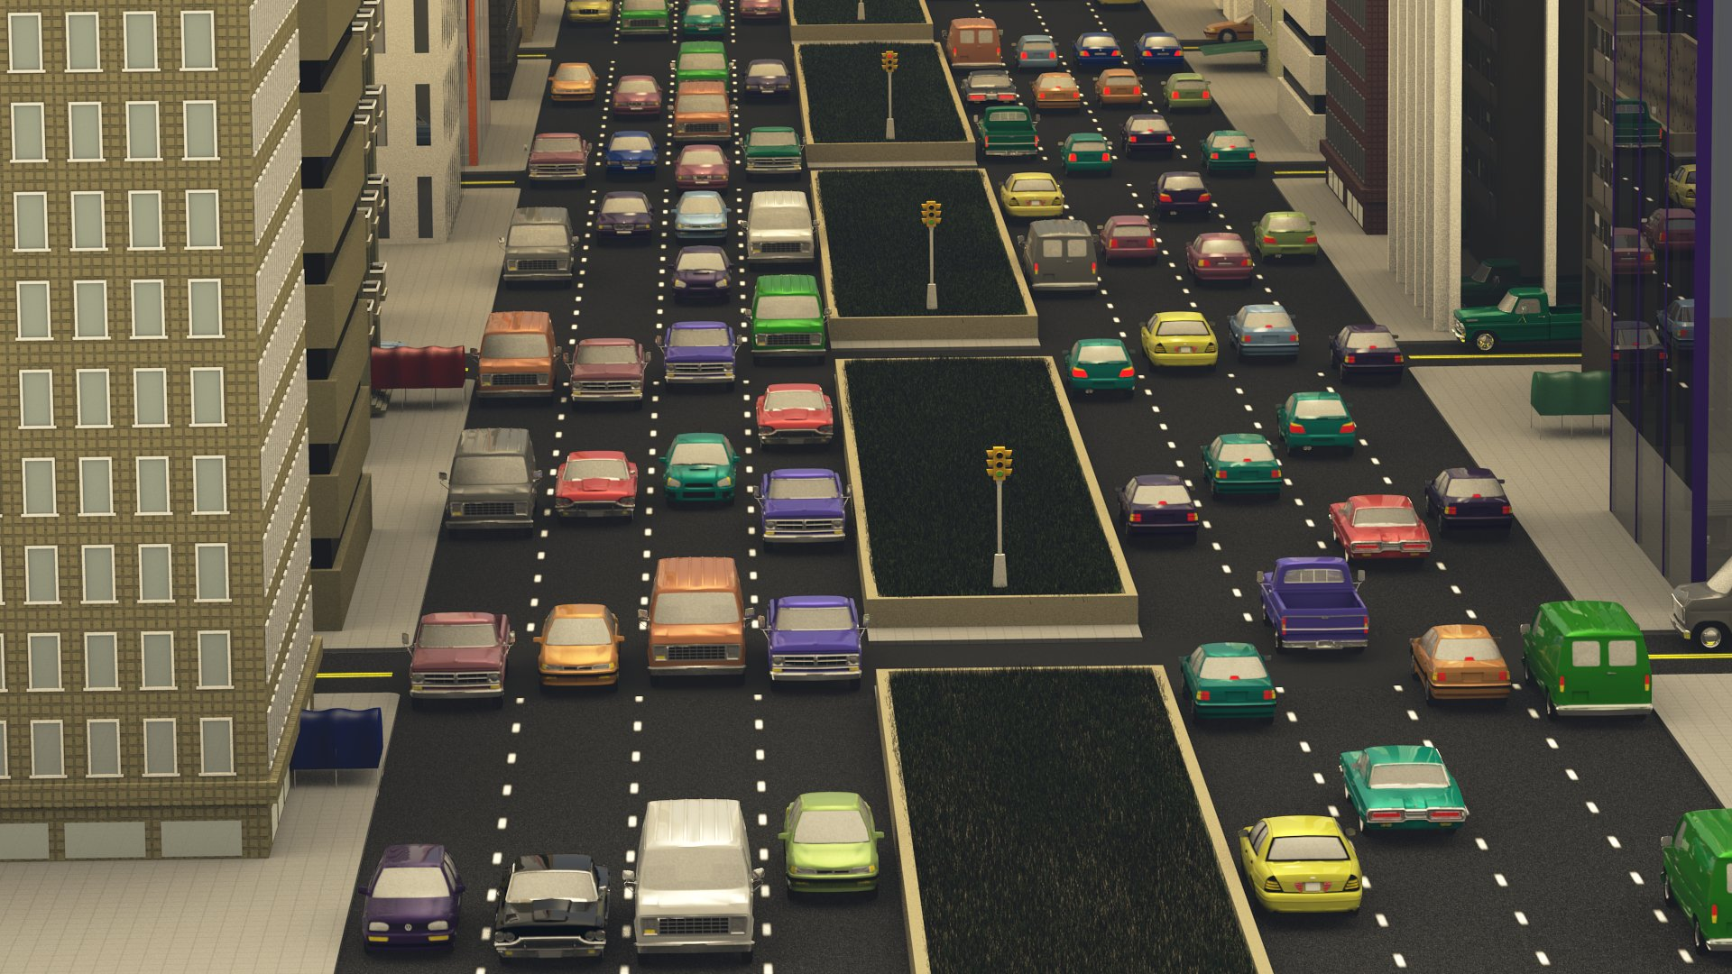
Traffic Simulation
We employ agent-based microscopic traffic simulations of 13 km stretch of a real world expressway for determining a methodology for spatial aggregation of FCD and to determine the minimum probe vehicle penetration.
Image courtesy http://gamma.cs.unc.edu/HYBRID_TRAFFIC/

Slide 22
Methodology
Microscopic models describe traffic from the perspective of individual driver-vehicle units (DVUs).
These high fidelity simulations help capture the heterogeneities in traffic in terms of different vehicles classes (e.g. cars, trucks) and driver behaviors (e.g. intelligent, aggressive).
The movement of DVUs are characterized by acceleration models for longitudinal motion and lane change models for lateral movement along the road.

Slide 23
Traffic Simulation
The microscopic simulation is based on the SEMSim platform.
SEMSim uses the Intelligent Driver Model (IDM) as the acceleration model for moving the agent/vehicle forward every time-step of the simulation.
The IDM is an accident free model which ensures that a vehicle attains the desired velocity at free flow and maintains the safe bumper to bumper distance to the leading vehicle.
Zehe, D., Knoll, A., Cai, W. and Aydt, H., 2015. SEMSim Cloud Service: Large-scale urban systems simulation in the cloud. Simulation Modelling Practice and Theory, 58, pp.157-171.
Treiber, M. and Kesting, A., 2010. An open-source microscopic traffic simulator. Intelligent Transportation Systems Magazine, IEEE, 2(3), pp.6-13.

Slide 24
Traffic Simulation
SEMSim uses MOBIL as the lane change model.
MOBIL ensures that the resultant accelerations and decelerations for a vehicle and its followers in the old and new lanes does not exceed a safe threshold.
A lane change is done only if a vehicle gains speed without violating the safety and inconvenience (to the old and new followers) criteria.
Kesting, Arne, Martin Treiber, and Dirk Helbing. "General lane-changing model MOBIL for car-following models." Transportation Research Record: Journal of the Transportation Research Board (2007).

Slide 25
Traffic Simulation
The traffic simulation takes as input a road network consisting of links and the lanes constituting each link.
Road links that do not have a preceding link are considered sources and those without a subsequent link are sinks.
Traffic thus flows from the sources to the sinks.
Vehicles are created at each source as a Poisson process with a constant mean inter-arrival time (IAT).
The route taken by each DVU is determined based on static turn ratios specified at each intersection.

Slide 26
Agenda
Background and motivation
Methodology
Experiments
Traffic Simulation
The simulated environment
Simulation parameters and Simulation scenarios
Results
Conclusions and Future Work

Slide 27
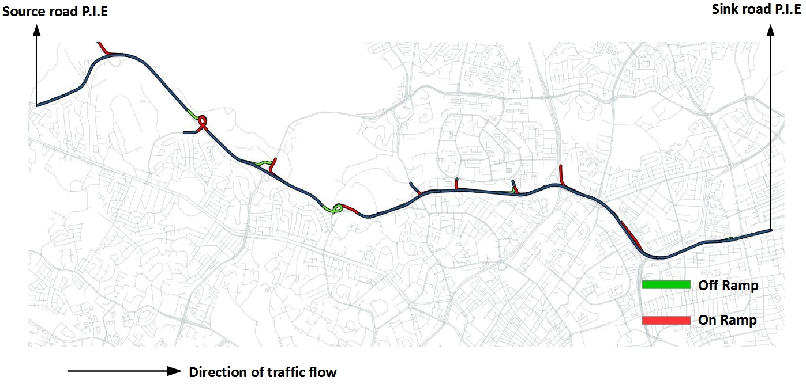
Simulated Environment
13 km stretch of P.I.E (Pan Island Expressway) in central Singapore with all on ramps and off ramps.

Slide 28
Simulated Environment
The on ramps and the first P.I.E link are sources for the vehicles/agents entering the simulation.
The off ramps and the last link on P.I.E are sinks through which the vehicles exit the simulation.
The turn ratios for all off-ramps is kept constant at 0.25. This implies that 25% of all vehicles exit at a given o ramp while the remaining 75% of the vehicles continue to travel on the main expressway.
The number of lanes in the simulated stretch of the expressway varies between 3 and 6.

Slide 29
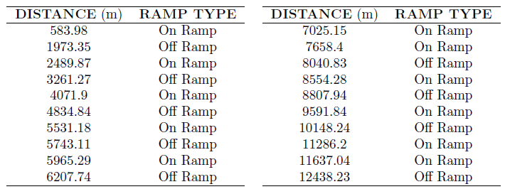
Simulated Environment
Location of all on and off ramps along the expressway
Notes:
For the sake of completeness

Slide 30
Agenda
Background and motivation
Methodology
Experiments
Traffic Simulation
The simulated environment
Simulation parameters and Simulation scenarios
Results
Conclusions and Future Work

Slide 31
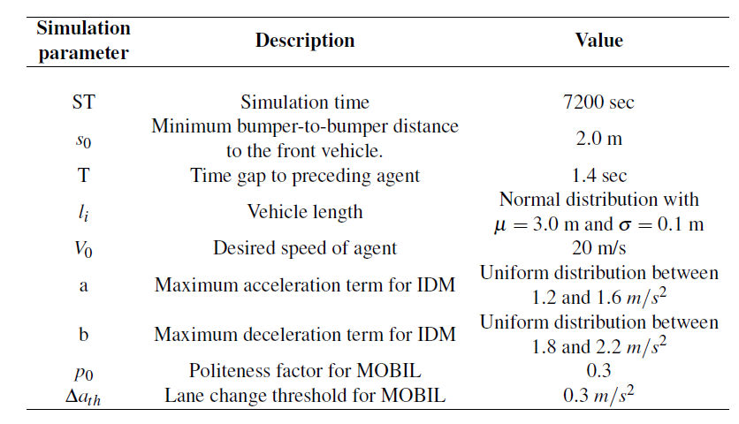
SEMSim Parameters
SEMSim parameters initialized at the beginning of each run

Slide 32
Simulation Scenarios
The traffic density in number of vehicles/km across the expressway is controlled by varying the average inter-arrival rates at all sources along P.I.E.
To simulate heavy congestion along P.I.E the mean IAT for all on-ramps was set to a uniform random number between 2.0 sec and 2.5 sec (while the mean IAT for the first and only source link of P.I.E was set to 1.0 sec.
The average traffic density (computed at the end of simulation) is 110 vehicles/km
The heat map represents the speed profiles of all the agents averaged over space and time intervals of 50 meters and 1 minute.

Slide 33
Simulation Scenarios
The spatiotemporal state of P.I.E during partial congestion.
The average vehicle density is 78 vehicles/km.
The spatiotemporal state of P.I.E during non peak traffic.
The average vehicle density is 65 vehicles/km.

Slide 34
Agenda
Background and motivation
Methodology
Experiments
Results
Conclusions and Future Work

Slide 35
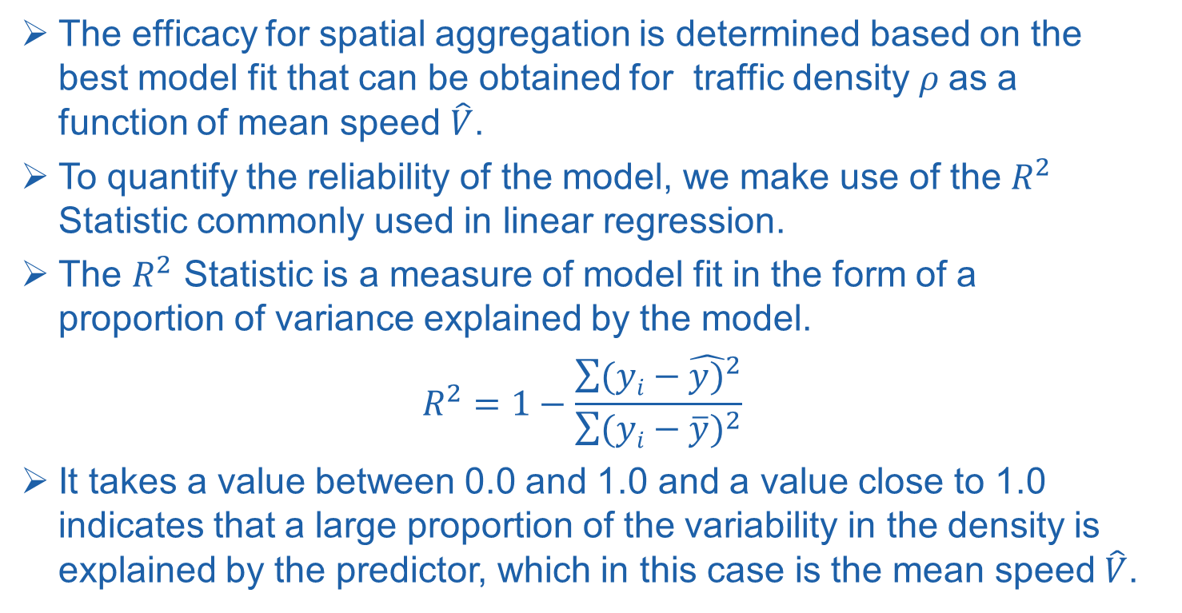
Results
The efficacy for spatial aggregation is determined based on the best model fit that can be obtained for traffic density $ρ$as a function of mean speed $\hat{V}$.
To quantify the reliability of the model, we make use of the $R^{2}$ Statistic commonly used in linear regression.
The $R^{2}$ Statistic is a measure of model fit in the form of a proportion of variance explained by the model.
$$R^{2}=1−\frac{\sum{({yi−\hat{y)}}^{2}}}{\sum{{(yi−\overline{y})}^{2}}}$$
It takes a value between 0.0 and 1.0 and a value close to 1.0 indicates that a large proportion of the variability in the density is explained by the predictor, which in this case is the mean speed $\hat{V}$.

Slide 36
Results
Density vs Average speed for 13 uniform partitions of length 1.0 km (100% probe vehicle penetration)
NAÏVE SPLIT
Density vs Average speed for 25 P.I.E road segments used as partitions (100% probe vehicle penetration)
TOPOLOGICAL SPLIT
Both the figures clearly establish an exponential relationship (based on the linear regression fit) between average speed and density despite significant bias.

Slide 37
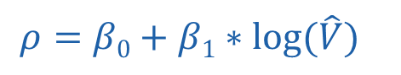
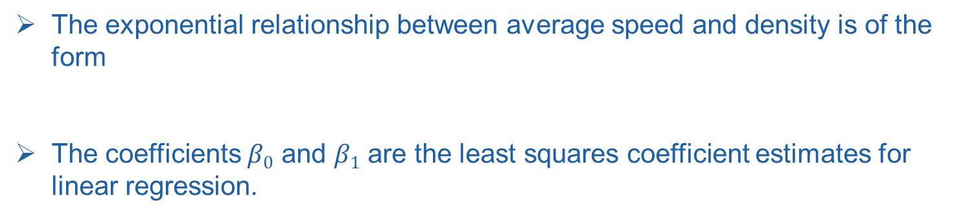
Results
Density vs Average speed for 12 segments using recursive binary splitting (100% probe vehicle penetration)
The exponential relationship between average speed and density is of the form
The coefficients $β0$ and $β1$ are the least squares coefficient estimates for linear regression.
$$ρ=β0+β1∗log⁡(\hat{V})$$

Slide 38
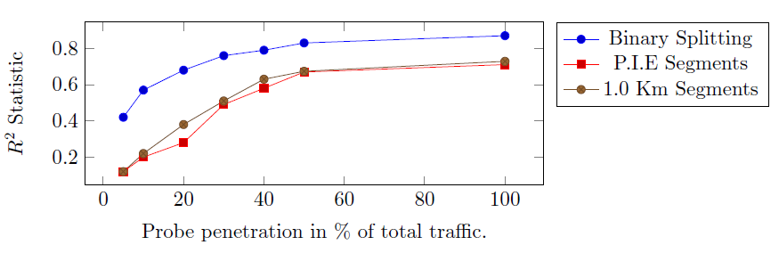
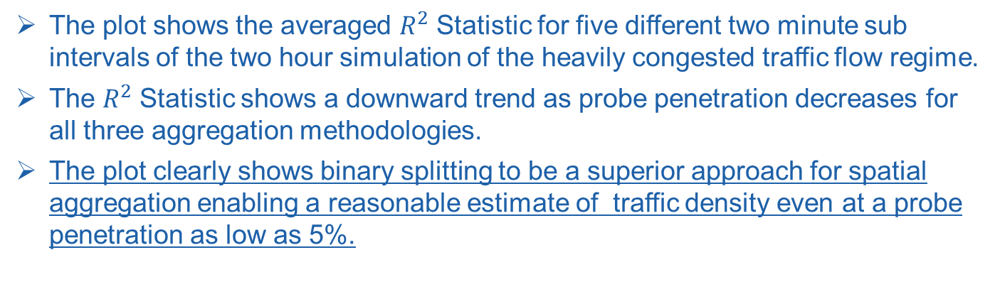
Probe Penetration for Effective Density Estimation
$R^{2}$ Statistic vs probe penetration for heavily congested traffic
The plot shows the averaged $R^{2}$ Statistic for five different two minute sub intervals of the two hour simulation of the heavily congested traffic flow regime.
The $R^{2}$ Statistic shows a downward trend as probe penetration decreases for all three aggregation methodologies.
The plot clearly shows binary splitting to be a superior approach for spatial aggregation enabling a reasonable estimate of traffic density even at a probe penetration as low as 5%.

Slide 39
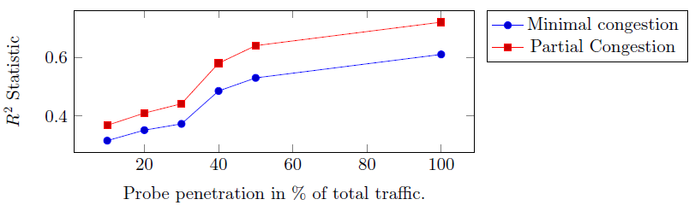
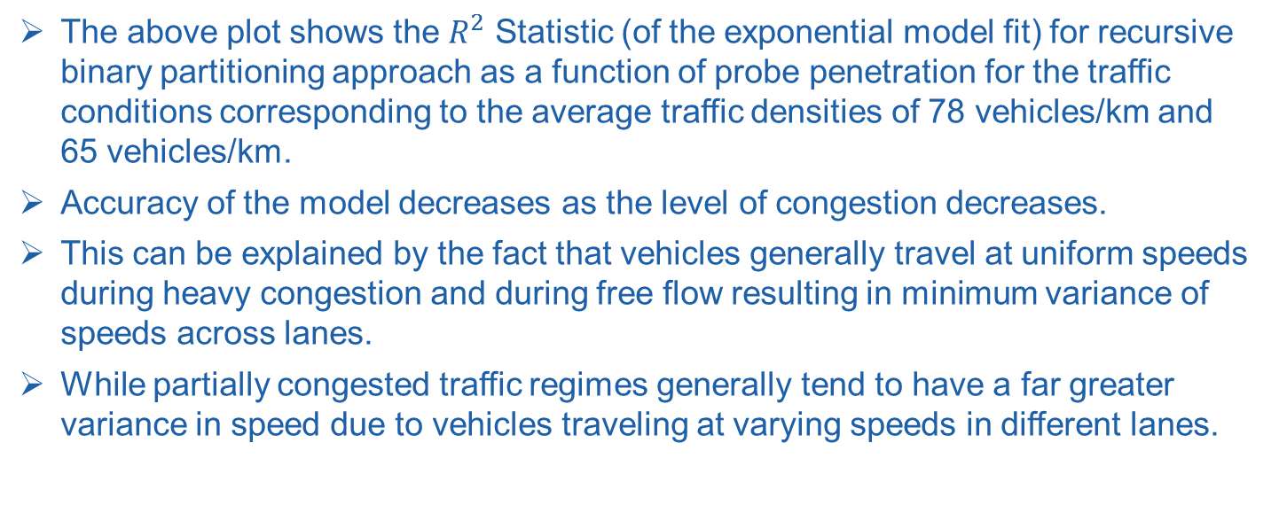
Results
The above plot shows the $R^{2}$ Statistic (of the exponential model fit) for recursive binary partitioning approach as a function of probe penetration for the traffic conditions corresponding to the average traffic densities of 78 vehicles/km and 65 vehicles/km.
Accuracy of the model decreases as the level of congestion decreases.
This can be explained by the fact that vehicles generally travel at uniform speeds during heavy congestion and during free flow resulting in minimum variance of speeds across lanes.
While partially congested traffic regimes generally tend to have a far greater variance in speed due to vehicles traveling at varying speeds in different lanes.

Slide 40
Agenda
Background and motivation
Methodology
Experiments
Results
Conclusions and Future Work

Slide 41
Conclusions & Future Work
CONCLUSIONS
In this work we have established that reliably estimating traffic state and more specifically density (and thereby flow) on an expressway can be achieved with a minimum of 5% to 10% probe vehicles depending upon the prevailing traffic conditions.
Microscopic traffic simulations reveal that recursive binary partitioning can be used to subdivide a stretch of road to identify relatively homogeneous regions of flow, density and average speed.

Slide 42
Future Work
Future work will involve optimizing the minimum variance partitioning of the road network to automatically detect onset of congestion and anomalous events such as accidents based on statistical learning methods.

Slide 43
Discussion on Future Work
What are the benefits of estimating traffic state in real-time?
Accurate estimation of speed, density and flow along important roads can help initialize data driven simulations for short term predictions of traffic flow.
Sunderrajan, Abhinav, Viswanathan, Vaisagh, Cai, Wentong, and Knoll, Alois. "Data Driven Adaptive Traffic Simulation of an Expressway." accepted in the 2016 Winter Simulation Conference.

Slide 44



Discussion on Future Work
Data driven adaptive traffic flow prediction and control
Data stream processing
Data from smart phones, GPS receivers and fixed sensors.
Traffic State
Predict and evaluate different control actions
Suggest the best control measure for dynamic traffic flow optimization.
Short term prognosis of traffic flow

Slide 45
Thankyou for your attention! Questions?

